Slide 1
Digital Portfolio
STUDENT NAME: NAVEEN KUMAR S
REGISTER NO AND NMID: 2422k0031.asbruap2422k0031
DEPARTMENT: Computer Science
COLLEGE: PPG Collage of Arts and Science,Bharathiar university

Slide 2
PROJECT TITLE
SIMPLE PORTFOLIO

Slide 3


AGENDA
Problem Statement
Project Overview
End Users
Tools and Technologies
Portfolio design and Layout
Features and Functionality
Results and Screenshots
Conclusion
Github Link
3/21/2024 Annual Review

Slide 4

Problem Statement
Many students and professionals need a simple, clean online presence to showcase their skills, projects, and contact information. The challenge is to create a lightweight, easy-to-maintain portfolio website that highlights the developer’s background and work using basic web technologies.

Slide 5

PROJECT OVERVIEW
The goal of this project is to build a personal portfolio website for naveen kumar s, a B.Sc. Computer Science student. The website will display naveen kumar s’s background, skills, and projects and provide a contact form for visitors to reach out. The project uses only HTML, CSS, and JavaScript to create a responsive, user-friendly site.

Slide 6

WHO ARE THE END USERS?
End Users
Potential employers or recruiters looking for naveen kumar s skills and projects.
Friends, classmates, or professional contacts who want to learn more about naveen kumar s work.
Anyone interested in web development who might benefit from seeing a simple portfolio example.

Slide 7

TOOLS AND TECHNIQUES
Tools and Technologies
HTML: To structure the content of the website.
CSS: For styling and layout, ensuring the site looks clean and professional.
JavaScript: To add interactivity, such as form validation and user feedback.
Browser: To view and test the website locally.
Text Editor (like VS Code, Sublime Text): To write and edit code.

Slide 8
POTFOLIO DESIGN AND LAYOUT
Portfolio Design and Layout
Header: Contains naveen kumar s name, degree, and navigation menu linking to sections (About, Projects, Contact).
About Section: Brief introduction about naveen kumar s and his passion for web development.
Projects Section: A showcase of simple projects to demonstrate coding skills.
Contact Section: A form where visitors can send messages directly (with basic validation).
Footer: Displays copyright info.
Responsive Layout: The site is centered with a max-width to keep content readable and spaced well.
Color Scheme: Dark header/footer with light content area for contrast and readability.
Clean and Minimalist: Focus on content without distractions.
8

Slide 9
FEATURES AND FUNCTIONALITY
Features and Functionality
Navigation Menu: Smooth and easy to access sections of the page.
About Me Section: Static text introducing naveen kumar s
Projects Section: Lists multiple projects with titles and descriptions.
Contact Form:
Input fields for name, email, and message.
Validation to ensure all fields are filled before submitting.
JavaScript alert confirms successful message submission.
Form resets after submission.
Responsive Design: Works well on desktop and smaller screens.
Consistent Styling: Uses CSS for layout, colors, fonts, and hover effects on buttons.
User Feedback: Alerts provide simple interaction feedback.

Slide 10
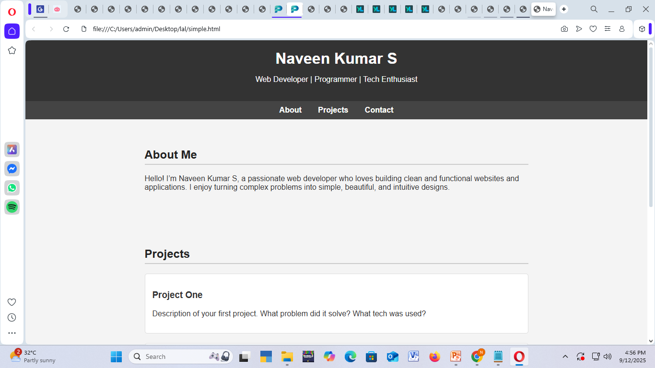

RESULTS AND SCREENSHOTS
3/21/2024 Annual Review
10

Slide 11
CONCLUSION
This portfolio website project successfully demonstrates the ability to build a clean, responsive, and functional personal website using only HTML, CSS, and JavaScript. It provides a solid foundation for showcasing skills and projects for potential employers or contacts.
11

